Slide 1
Packet Tracer: Inicio
Notes:
Cisco Networking Academy Program
Packet Tracer: Novice Session
Welcome. This 60-minute session will not allow much opportunity for you to speak so during the session please feel free to type questions in the WebEx chat window.
Thank you for participating in this session of Packet Tracer. To get an idea of the experience-level of this group, I would like to ask you a few questions and ask you to use the yes and no indicators to respond. If you look in the right-hand side of the WebEx window, you should see the yes and no buttons. Click on the yes button to demonstrate that you have found it. Thank you.
Have you seen or tried any version of PT before?
Have you used any version of PT before in your teaching?
The goal of this session is to demonstrate how you can begin using Packet Tracer in your classroom.

Slide 2
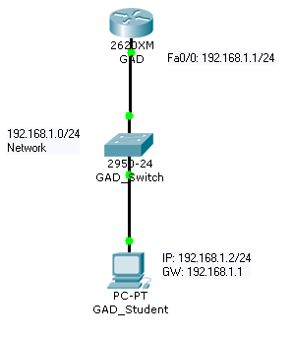
Contenido
Crear y organizar dispositivos
Crear conexiones
Configurar dispositivos
Verificar la conectividad
Simulación
Dudas para principiantes
Notes:
Slide 4 – Skills Demonstrated in this Session
In this demonstration, we will use the most basic features of Packet Tracer. Like many software programs, PT has many more features than you might want to use at first. But, just like you can use Microsoft Word to do very basic word processing, you can use PT to configure very basic networks.

Slide 3

Devices
Crear y organizar dispositivos
Connecting Devices
Notes:
Slide 5 – Creating and Arranging Devices

Slide 4
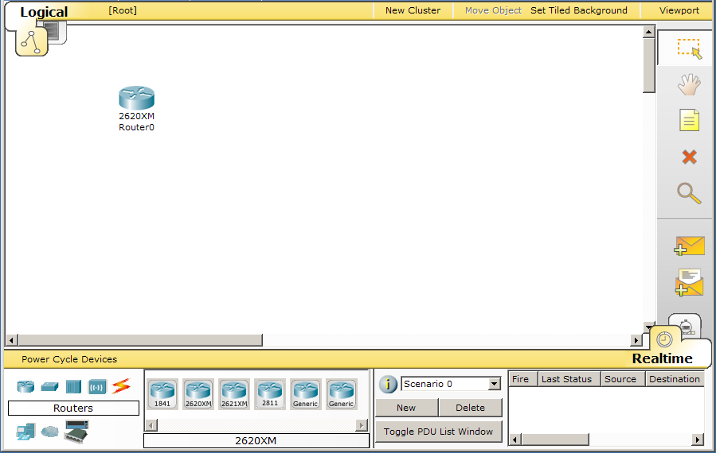


Crear los dispositivos
Para crear un dispositivo:
1. Selecciona la herramienta Select (si es necesario).
4. Ubicalo en el espacio de trabajo.
2. Elige el tipo de dispositivo
3. Elige un dispositivo
Notes:
Slide 6 – Create the Devices
The large white space that opens by default is the workspace where you will create your topology. You can use the entire white space and can even scroll down and to the right to utilize a larger area.
Since our topology is very small, we will use only the left portion of the screen. This will help us with workspace later when we are running a simulation.
In this demonstration, we can use any of the routers listed. In other topologies, you may direct students to use specific router types, as you may need specific modules added to the devices.

Slide 5
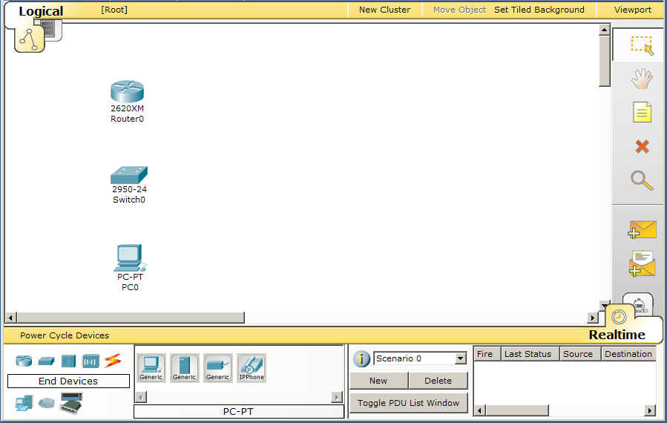
Herramientas
La barra de herramientas incluye:
Select para seleccionar
Move para mover toda la topología
Note para añadir notas a la topología
Delete para borrar dispositivos o conexiones
Notes:
Slide 7 – Common Tools
The Common Tools Bar contains tools you will use regularly to interact with the work space:
The Select tool is used to drag, highlight and select devices.
The Move Layout tool is used to move the workspace
The Place Note tool is used to add notes or labels in the workspace
The Delete tool is used to delete devices and links.

Slide 6
Algunos Trucos
Puedes crear multiples instancias del mismo dispositivo pulsando la tecla CTRL
Para cancelar la creación de un dispositivo pulsa en el de nuevo o en otra herramienta. Con la tecla ESC se puede cancelar cualquier acción.
Se pueden seleccionar varios dispositivos al mismo tiempo usando la herramienta de selección y seleccionando los dispositivos deseados.
Notes:
Slide 8 – Some Tips
If you would like to create multiple instances of the same device, hold down the CTRL key before clicking on the device. Click in the workspace placing a new device with each click.
To cancel the process of creating multiple instances, click on the device again. (You can also hit the ESC key or simply click on another tool.)
Devices can be dragged to a new location. Multiple devices can be selected by clicking and dragging a selection box around the desired devices. You can also hold down the SHIFT key while you click on multiple devices you wish to make part of your multiple selections. Once selected, highlighted devices can be moved around as a unit.
A multiple selection can also be deleted by clicking on the Delete tool. The Delete tool can also be used to delete one device at a time.
Use the Move Layout tool in place of the horizontal and vertical scroll bars to reposition your topology if it gets too big or if other windows are blocking your view.
Use the Place Note tool to add information directly to the topology instead of using the Network Information window.
The Inspect tool allows you to look at a device’s table such as the ARP, MAC and routing tables.
At any point, you can save your topology using the Save button on the tool bar or the Save command from the File menu. Be sure to save it with the .pkt extension.

Slide 7

Devices
Conectar los dispositivos

Slide 8
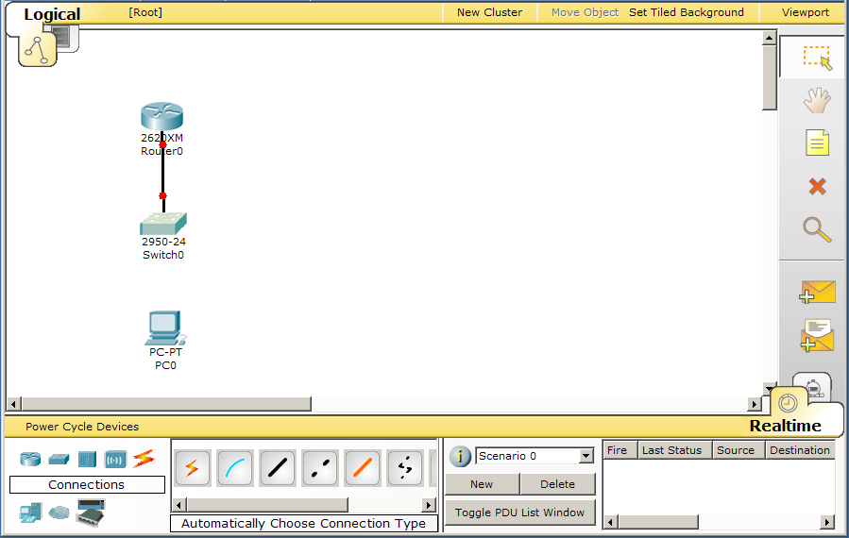
Conexión rápida
Conectar los dispositivos:
4. Pulsa en el primer dispositivo.
1. Selecciona la herramienta Select (si es necesario).
5. Pulsa en el segundo dispositivo
2. Elige el icono de conexiones
3. Selecciona el icono de conexión rápida
Notes:
Slide 14 – Smart Connection
The Smart Connection is the easiest way for students to make connections between devices.
The Smart Connection will select the most common type of connection between devices. For instance, when connecting a router to a switch, the program will use a FastEthernet connection if a FastEthernet interface is available on both devices.
Later, when students have more skills with both Packet Tracer and networking, they will be able to choose a connection type and an interface manually.
Packet Tracer supports various connection types, including a console connection, crossover and straight through copper connections, serial DCE and DTE connections, coaxial, fiber, and phone lines.

Slide 9
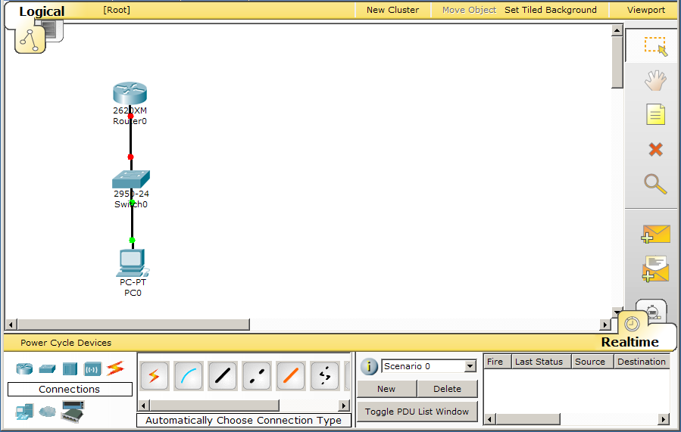
Estado de los interfaces
El punto rojo indica que no hay conexión.
El estado por defecto de los interfaces del router es “shutdown”.
Notes:
Slide 15 – Port Status
Point out to students that the link between the switch and the router is down. This is because the FastEthernet interface on the router is “shutdown”.
The link between the PC and the switch is up, because the interfaces on these devices start up in an operational state.
These link lights are a quick visual way to determine if your links are operational.

Slide 10

Consultar los puertos
Situa el ratón sobre las conexiones para ver qué puertos se han ocupado al hacer la conexión.
Situa el ratón sobre los dispositivos para ver todos sus puertos, características y el estado.
Notes:
Slide 16 – Viewing Port Labels
When using the Smart Connection, you may need to mouse over the connection to determine which ports on the devices were used for the connection.

Slide 11
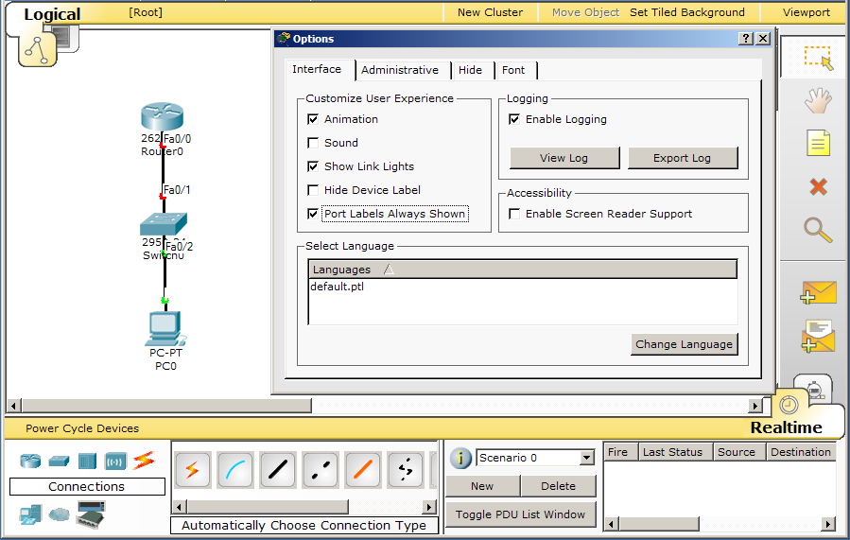
Opciones de los puertos
Notes:
Slide 17 – Port Label Options and Other Options
Alternately, you can choose to have Port Labels Always Shown from the Options menu.
Features in PT4.1 or greater are the Show Link Lights option and the Hide Device Label option. Use these options to show or hide the device link lights and the device labels.

Slide 12
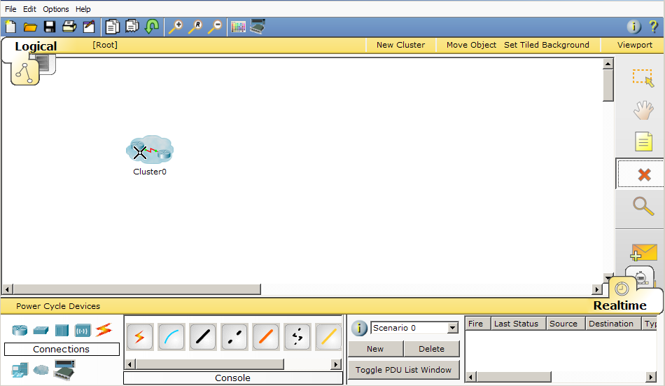
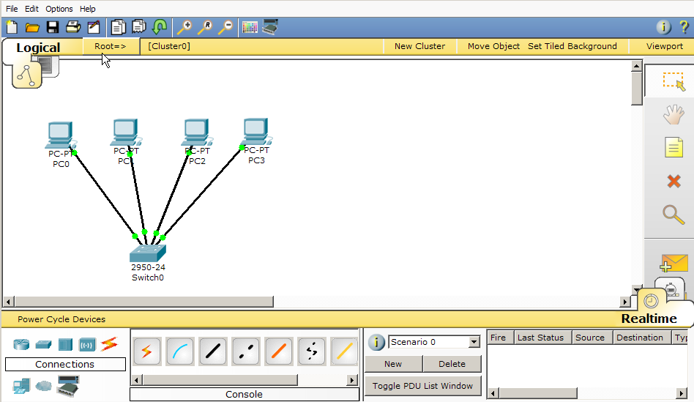

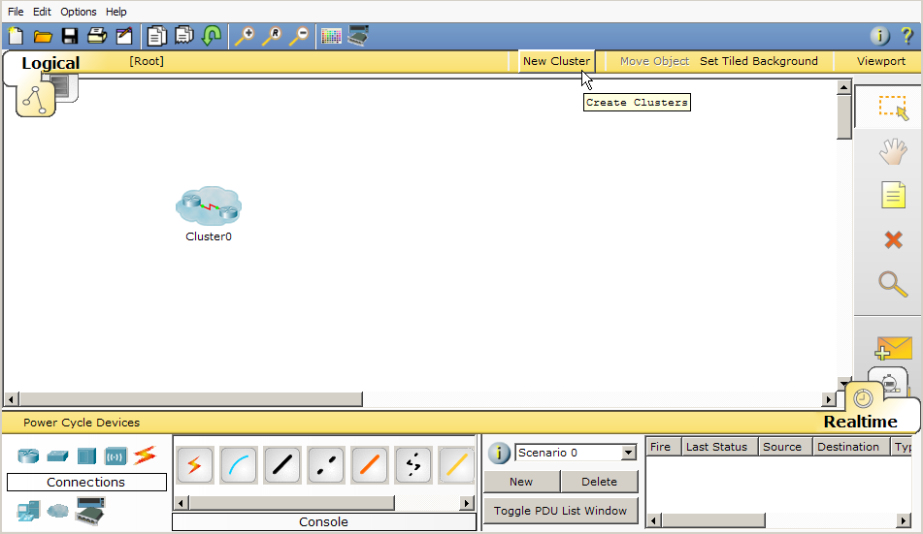

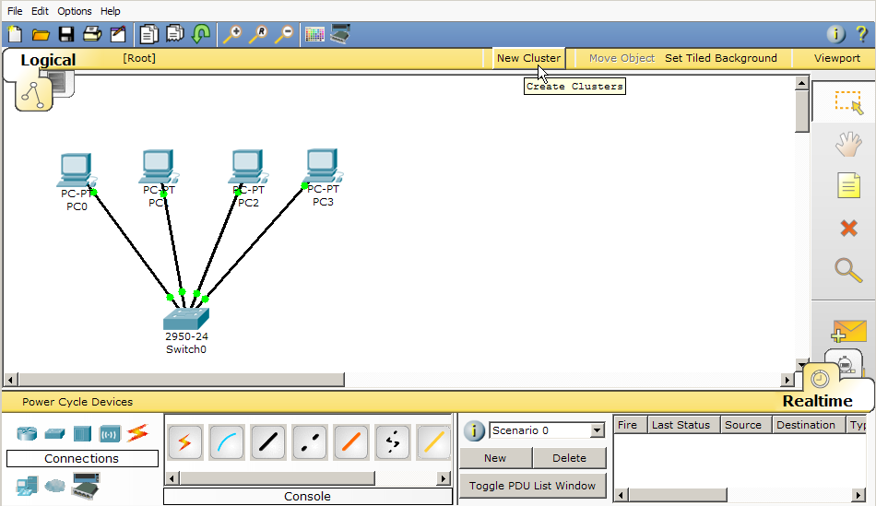
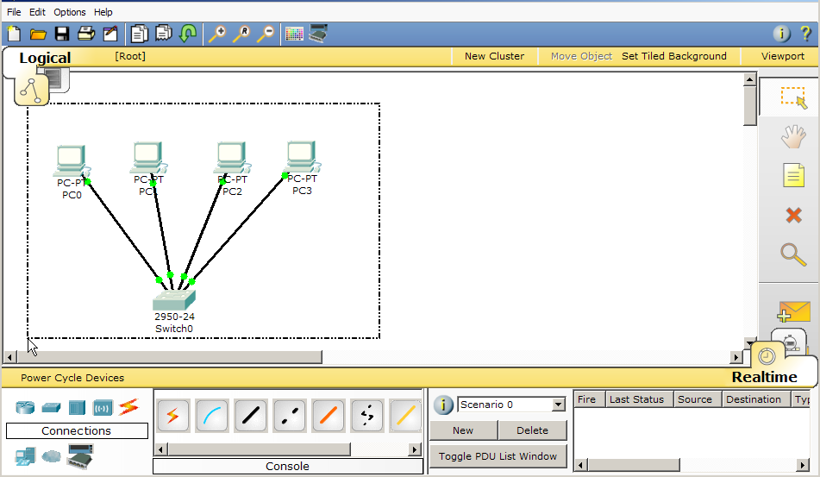
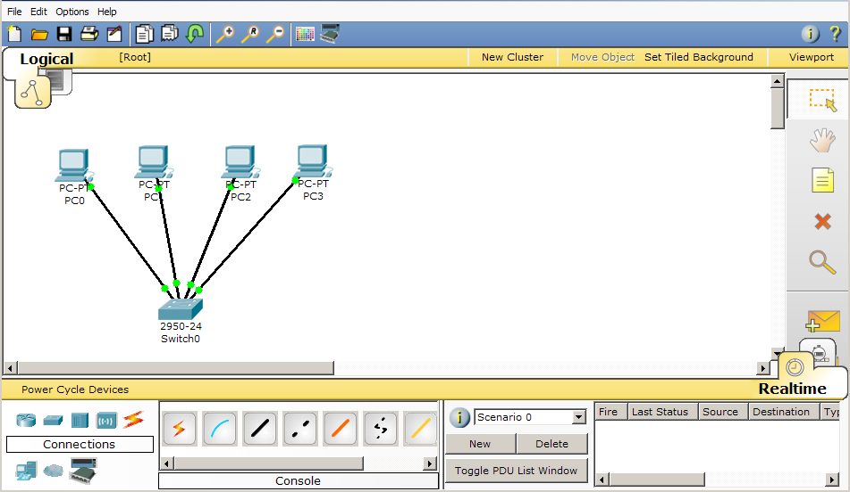
Agrupar dispositivos
Por defecto una red se crea en la raiz.
Se pueden agrupar los dipositivos para simplificar la red en el espacio de trabajo.
Selecciona los dispositivos que van a forma parte del nuevo cluster.
Notes:
Slide 18 – Clustering Devices
PT4.1 or greater includes the feature of clustering devices to simplify the appearance of the Logical Workspace. Clustering reduces a group of devices and connections into a single image.
By default, devices are created in the Root level, which is indicated on the Logical/Physical Workspace Bar. In this slide, you see a small network of 4 PCs and a switch and this network is located at the Root level in the Logical Workspace.
To cluster this small network, select the devices on the workspace and then click on the New Cluster button.
To drill down into the cluster, simply click on the cluster. Notice in the navigational bar Cluster0 is listed.
To move back to the Root level, click on Root in the navigational bar.
To rename the cluster, click on its label to enable the label textbox.
To uncluster a group of devices, highlight the cluster and then delete it with the Delete tool.

Slide 13
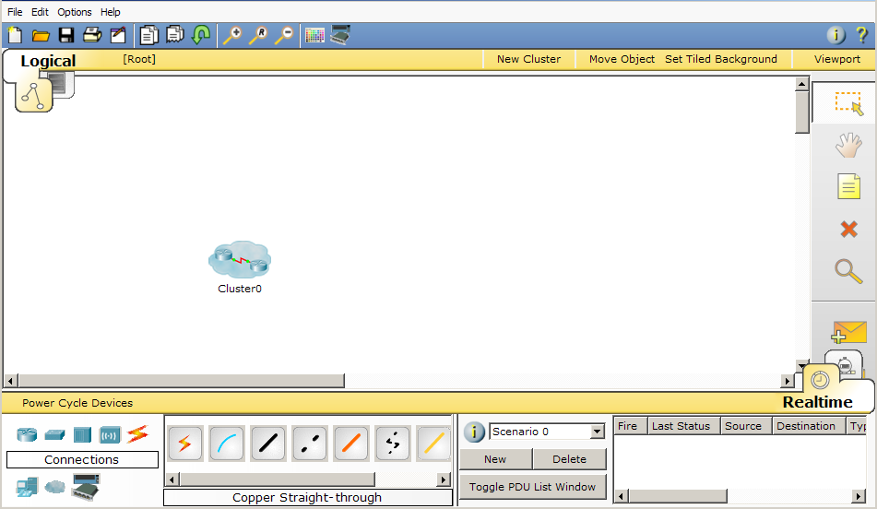
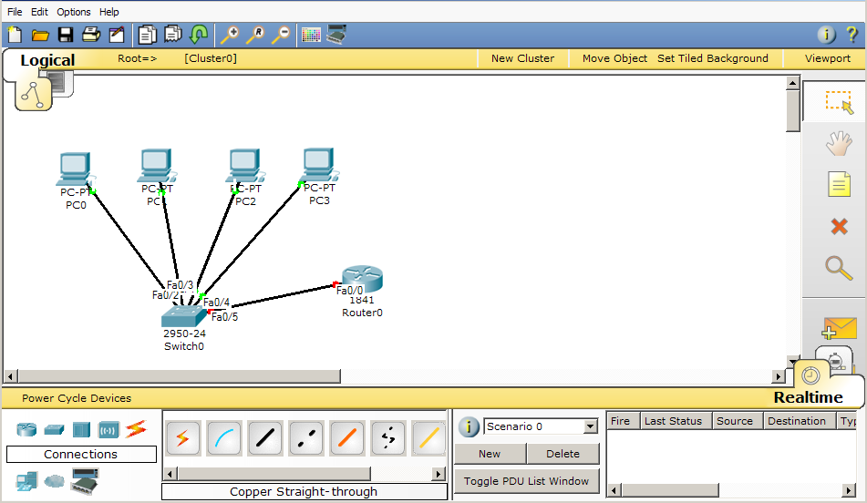
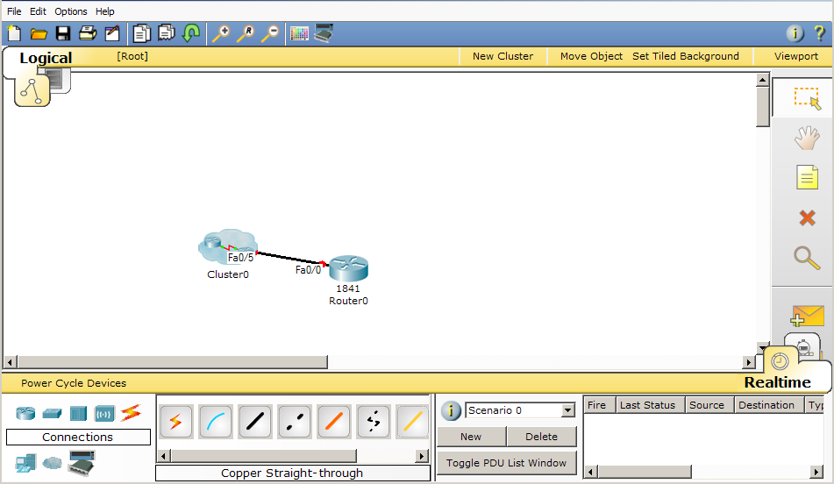
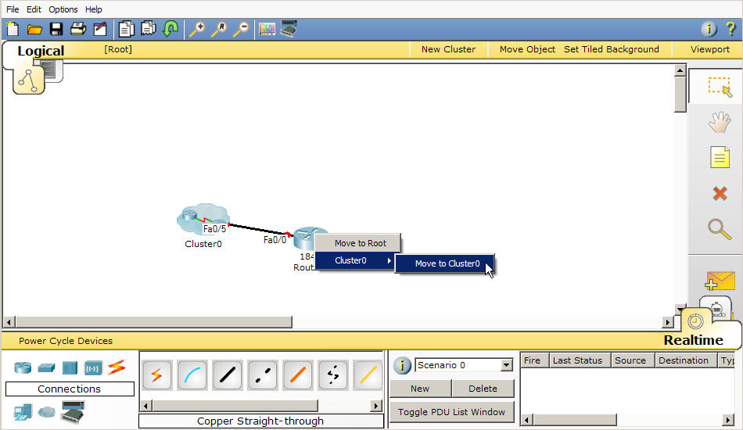
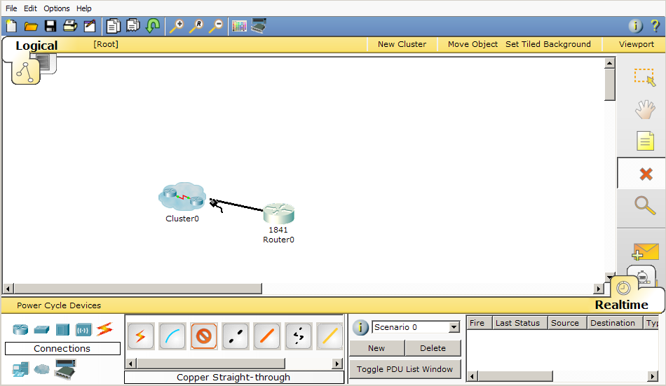
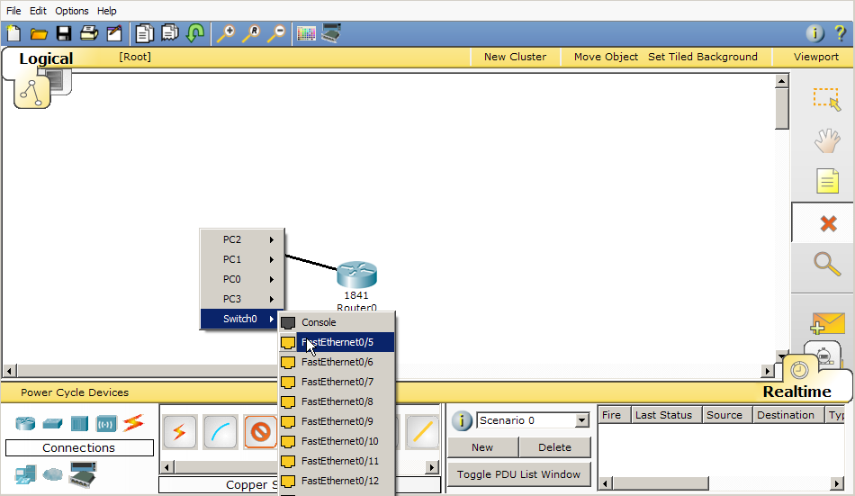
Conectar un dispositivo a un cluster
Notes:
Slide 19 – Connect to a Device Within a Cluster
You can make a connection from a device outside of a cluster to a device within a cluster. In this example, the router is connected to the switch within the cluster using a copper straight-through cable.
Select the connection type of a copper straight-through cable. Click on the router and select one of the FastEthernet interfaces.
Then click on the cluster. From the menu, select Switch0 and then select one of the FastEthernet interfaces on the switch.
Let’s say you have decided that the router should have been created within the cluster instead of outside of the cluster. You can move the router into the cluster using the Move Object button.
Click on the Move Object button
Also, when you can create a cluster, you can move objects and devices within the cluster hierarchy with the Move Object button. To do so, click on the Move Object button and then select an object or device. This opens a menu showing the cluster hierarchy. You can then select the location to which the object should be moved.

Slide 14

Configurar dispositivos
Configuración básica
Notes:
Slide 20 – Configuring Devices
GUI Configuration
The equivalent IOS commands that are displayed by PT during GUI configuration allow you to reinforce configuration commands with students.
Remember the GUI only allows for very basic configuration. More advanced configuration will be done through IOS.

Slide 15
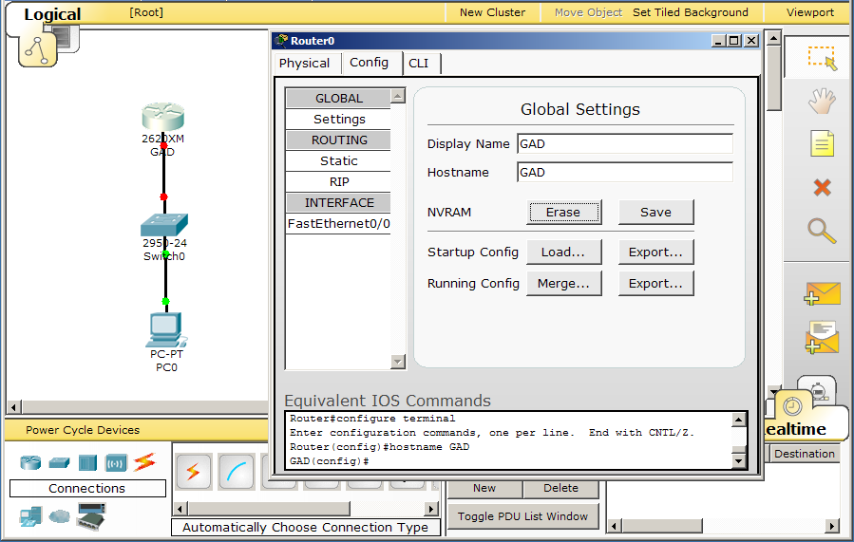
Configurar el nombre del router
2. Escribe el nombre del host en el Display Name y en el Hostname
1. Para configurar un dispositivo, haz doble click y selecciona la pestaña Config.
3. El nombre se actualiza en la topología.
4. Aquí se muestra el comando del sistema equivalente.
Notes:
Slide 22 – Configuring Router Hostname
To begin configuring a router or a switch, click on it and then click on the Config tab.
In Global Settings, type in the Router Name in both the Display Name field (updates the topology) and the Hostname field (updates the configuration).
You can use the “Erase” or “Save” buttons to erase NVRAM or save the current configuration to NVRAM.
In the “Equivalent IOS Commands” window, you will see the commands for every action you take under the Config tab.
Change the name of Router0 to GAD and save the change to NVRAM.

Slide 16
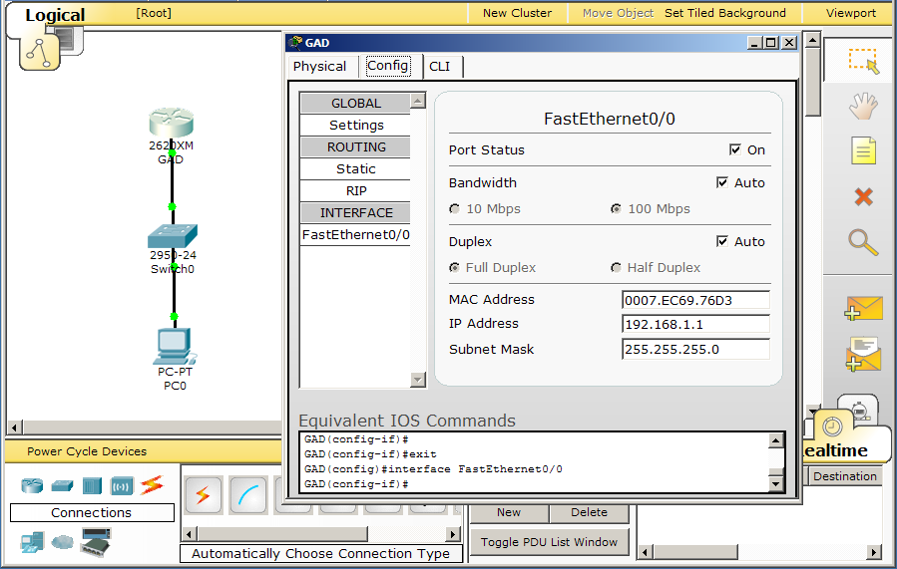
Configurar el Interfaz del Router
Selecciona el interfaz a configurar.
3. Activa el interfaz.
4. Los links activados pasan a verde. Se pueden ver los pasos equivalentes en la linea de comandos.
2. Introduce la dirección IP y la máscara.
Notes:
Slide 23 – Configure Router FastEthernet Interface
To configure an interface under the Config tab, choose the interface, configure its addressing, and then set the “Port Status” to “On”. The actual commands are shown in the “Equivalent IOS Commands” window.
Configure the FastEthernet0/0 interface
IP Address: 192.168.1.1
Subnet Mask: 255.255.255.0 (The subnet mask will automatically be populated.)
Turn Port Status to On to activate the interface.
IOS commands are updated and the link light is now green.

Slide 17
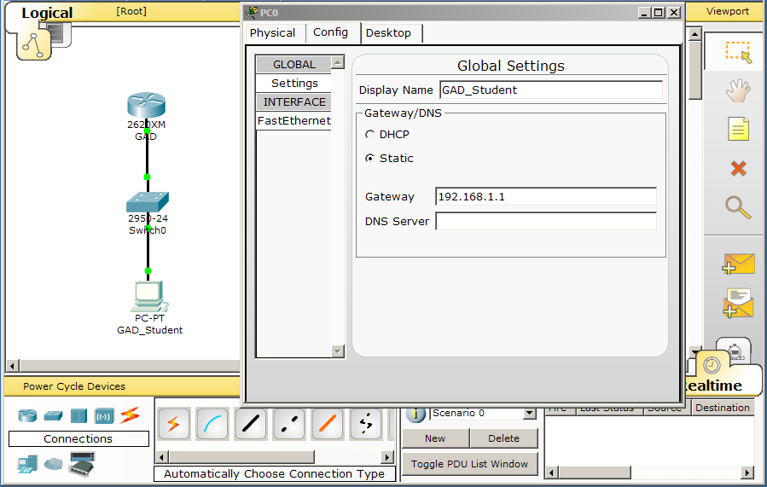
Configurar el Gateway de un PC
Selecciona el PC y la pestaña Config para configurarlo.
En GLOBAL Settings, puedes cambiar el nombre del PC e introducir la IP del gateway.
Notes:
Slide 24 – Configure the PC Gateway
After clicking the PC icon in the topology, navigate to the Config tab to enter settings for the Gateway and Display Name.
No two devices can share the same name in Packet Tracer; therefore, if you have a router named “GAD”, no other device can have this name.

Slide 18
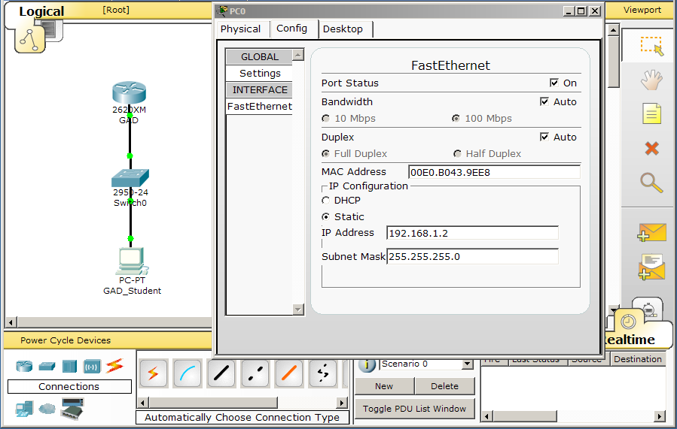
Configurar la dirección IP de un PC
Selecciona el interfaz FastEthernet para configurar su dirección IP y su máscara.
Notes:
Slide 25 – Configure the PC IP Address
Select the FastEthernet link to configure the IP address and Subnet Mask.
The default subnet mask will be filled in automatically when you tab from the IP address field.
Note that Bandwidth and Duplex can be set to “Auto” to simplify configuration for beginning students.

Slide 19
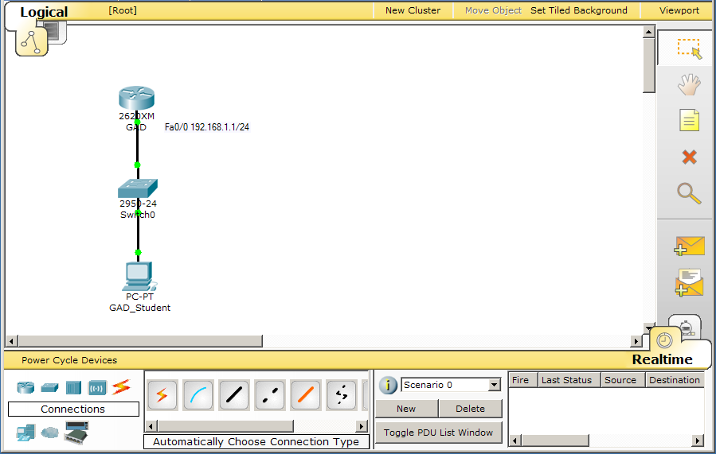
Añadir notas
Selecciona la herramienta Note para añadir notas a la topología.
Notes:
Slide 26 – Add Notes
Notes are helpful reminders of configuration settings.
Notes can be added, moved and deleted from the topology just like devices.

Slide 20
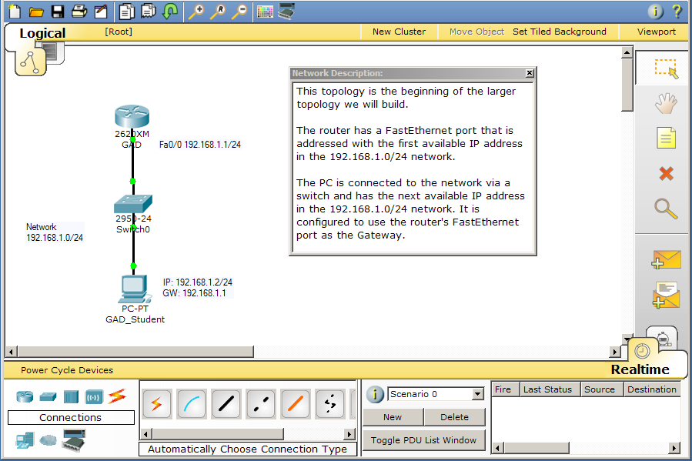
Descripción de la red
Selecciona el icono de información “I” para añadir una descripción de la red.
Notes:
Slide 27 – Network Description
You can use the Network Description text box to enter a description for the current network or other helpful information. When the saved file is opened by a user, this information can be displayed and will help the user understand the topology.
Clicking the “I” icon will show the window. Clicking the “x” will close the window.

Slide 21
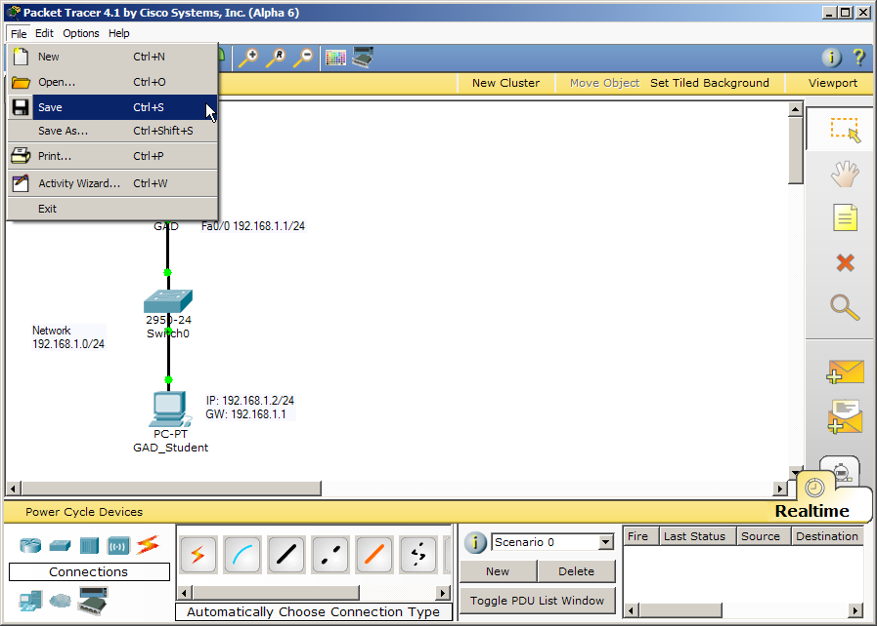
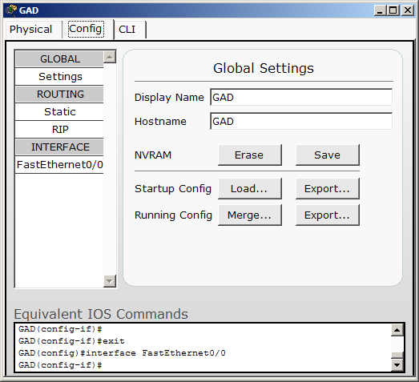
Guardar la red y su configuración
Para guardar el fichero File…Save
Para guardar la configuración del router selecciona en NVRRAM el botón Save.
Notes:
Slide 28 – Save Your Configurations and File
Router configs are lost if not saved when the router is powered off.
PC configs are saved automatically.
Packet Tracer files are saved with a .pkt ending. You can save the files anywhere on your computer or your network. Once saved, the file can be reopened and will contain all of the devices and configurations you entered.

Slide 22

Verificar la conectividad
Notes:
Slide 29 – Verify Connectivity

Slide 23
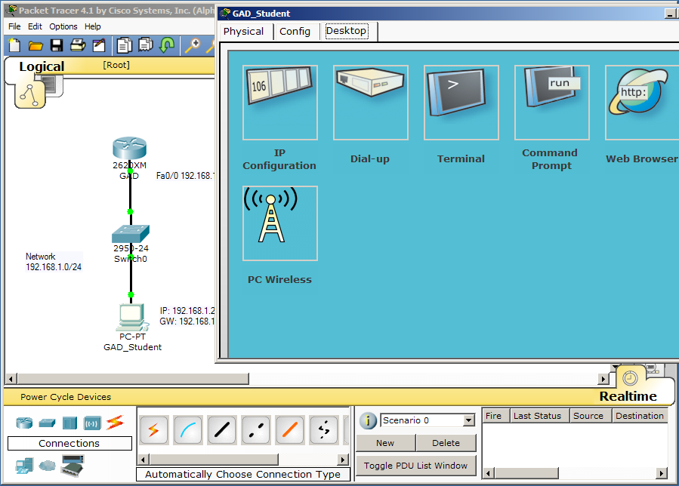
Verificar en tiempo real
En el modo Realtime, selecciona Desktop de las propiedades del pc. El icono Command Prompt abre una ventana de comandos del PC.
Notes:
Slide 31 – Verifying in Realtime Mode
Click the PC icon in the workspace to open the PC options window.
Select the Desktop tab.
Click the Command Prompt icon to open a command prompt window from the PC.

Slide 24
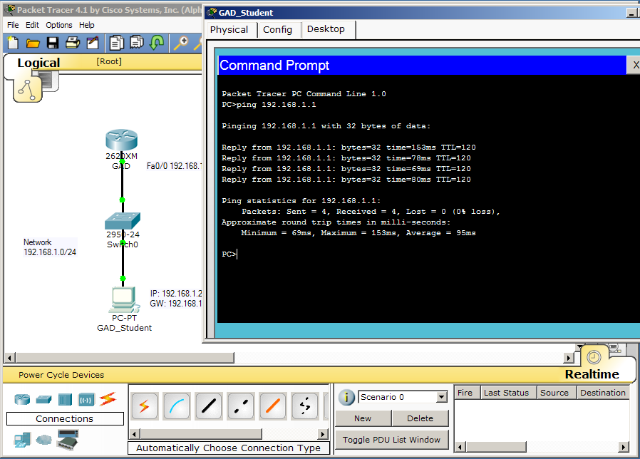
Hacer un ping al gateway
Hacer un ping al gateway
Notes:
Slide 32 – Ping the Gateway
Remember that this is Realtime mode, so packets are processed in real time just as they are using real equipment.

Slide 25
Devices
Ejecutar una simulación
Connecting Devices
Notes:
Slide 33 – Run a Simulation

Slide 26
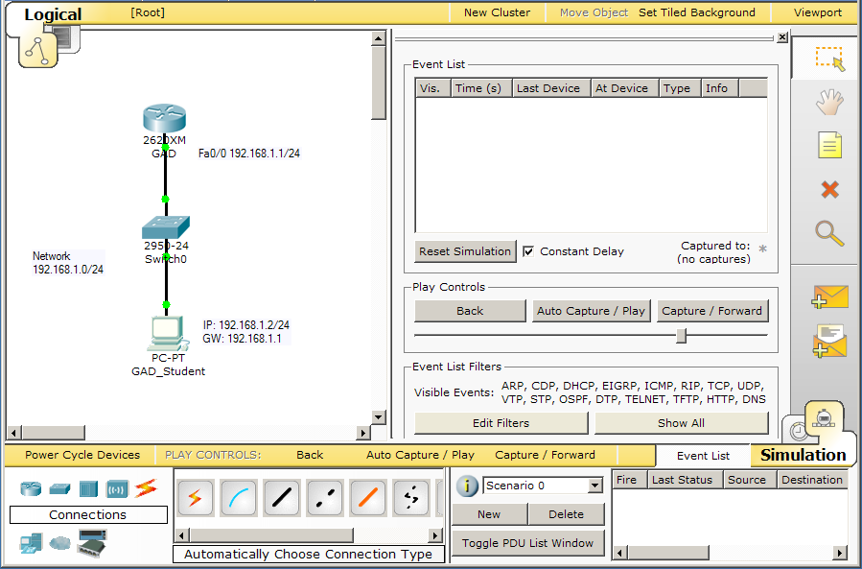
Modo Simulación
Selecciona el modo simulación
Notes:
Slide 34 – Simulation Mode
Remember that in Simulation Mode, you can watch your network run at a slower pace, observing the paths that packets take and inspecting them in detail.

Slide 27
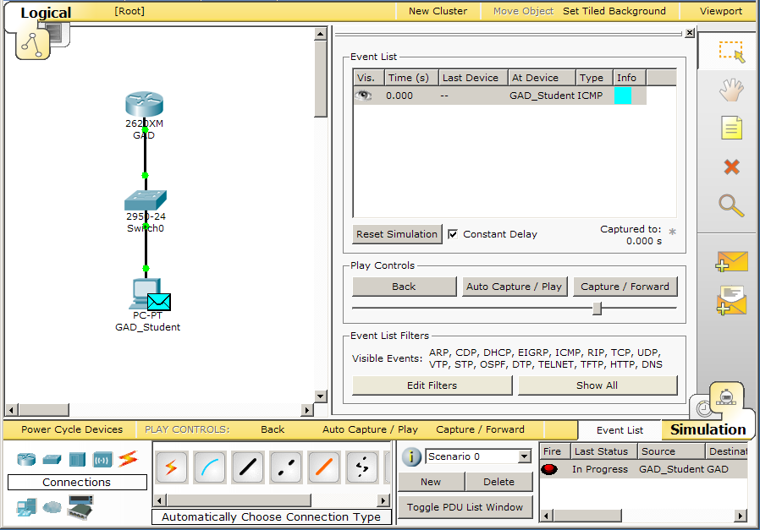
Crear una PDU
3. Selecciona el dispositivo destino
1. Selecciona el icono de PDU simple.
2. Selecciona el dispositivo fuente.
Notes:
Slide 36 – Create a PDU
The Add Simple PDU button is essentially a quick, graphical way to send pings.
You can send pings between devices that have at least one interface with an IP address.
To send a ping, press the Add Simple PDU button (the cursor changes to a "packet" icon), click on the source device, and then click on the destination device. Note that pings will only work if the devices have configured ports.
After you make the request, the source device will queue an ICMP or ARP packet (or both), which will be on standby until you press the Auto Capture/Play or Capture/Forward button. When you press one of these buttons, the packets will start moving and you can observe the ping process.

Slide 28
Lista de eventos
La ventana de lista de eventos registra (o “captura”) lo que ocurre mientras la PDU se propaga por la red.
Se puede filtrar el tipo de paquetes que se quieren mostrar.
Aquí se muestra información de la PDU.
Notes:
Slide 37 – Event List
The Event List window records (or "captures") what happens as your PDU propagates the network.
If you filter out some type of PDUs on the Event List Filters, they will not show up on the Event List. They are still in the network; you just do not see them.
The simulation runs more quickly because you will not see the filtered events, but all filtered PDUs still affect the network.

Slide 29
Ejecutar la simulación
Selecciona el botón Auto Capture/Play para comenzar la simulación
Notes:
Slide 38 – Playing the Simulation
Auto Capture/Play will play the simulation from beginning to end.
Capture/Forward will move the packet forward one hop at a time with each click of the Capture/Forward button.

Slide 30
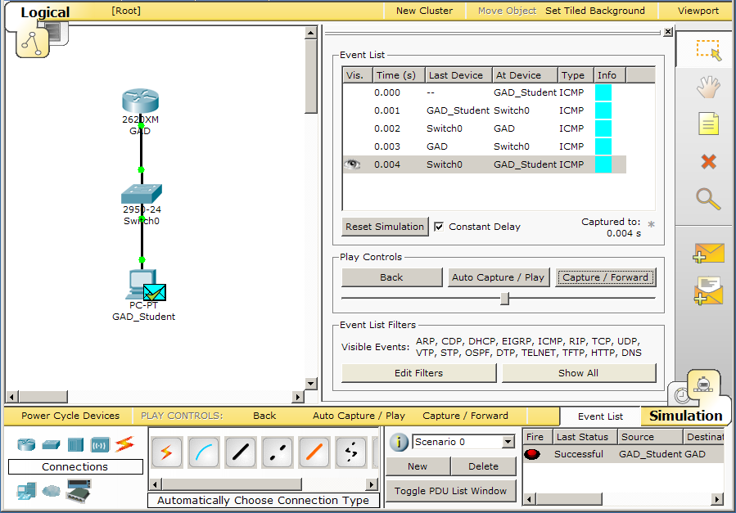
Resultados
Mientras se ejecuta la simulación se añaden eventos a la lista. Estos eventos muestran el estado de los paquetes paso a paso a lo largo del recorrido de origen a destino.
Si el ping tiene éxito se mostrará una marca verde.
Notes:
Slide 39 – Results
Packet Tracer simulations do not run on a linear time scale. Time is determined by the events that occur. An event can be defined as any instance of a PDU that is generated in the network. The Event List keeps track of all such PDU instances and lists their information in various fields:
Fields in the Event List:
Visible: An "eye" icon in the field means that an event is happening at the current simulation time. Packets that are currently visible in the scenario animation will have this icon in the field.
Time: This field indicates the timeframe that the event occurred, relative to the last time the simulation scenario restarted. This field is also the simulation time index.
Last Device: This field indicates the packet's previous location.
At Device: This field indicates the packet's current location.
Type: This field indicates the packet type.
Info: This field shows detailed information about the packet instance, broken up into each layer of the OSI model.

Slide 31
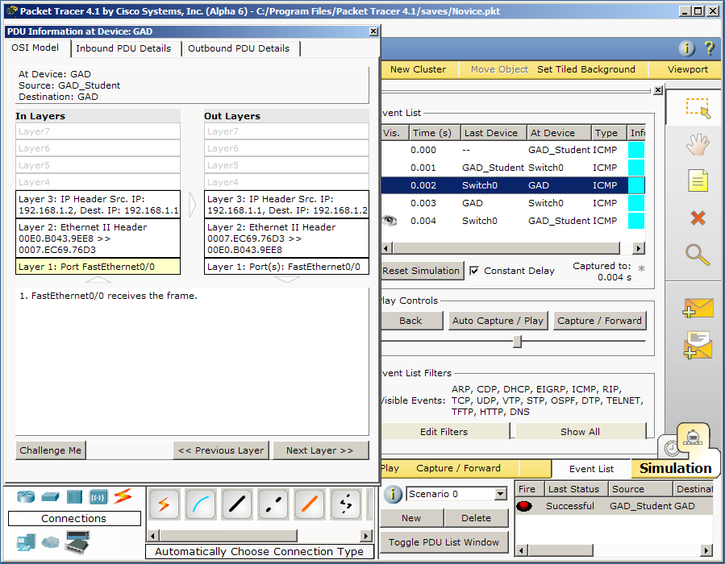
Información de la PDU
Notes:
Slide 40 – PDU Information
During a simulation, you can click on a packet (on the topology or the corresponding event in the Event List) to bring up its information window and view its details. The details window contains three possible tabs: OSI Model, Inbound PDU Details, and Outbound PDU Details.
The OSI Model tab shows how the packet is processed at each layer of the OSI model by the current device. The process is further separated by the direction in which the packets are traveling—incoming versus outgoing. The incoming layers (In Layers column) show how the device processes an incoming or a buffered packet, and the outgoing layers (Out Layers column) show the process a device goes through when it sends a packet to one or multiple ports.
The Inbound PDU Details tab only applies if the PDU you clicked on is being received on the device; it will not appear if the PDU originated from that device. The tab shows exactly what is in the header of the PDU, broken up into header type and the individual fields in each header. For example, a PDU may have an Ethernet II and an ARP header, so the tab will show information such as the preamble, FCS, and source and destination addresses.
The Outbound PDU Details tab shows similar information for outgoing packets. This tab only applies if the device has a PDU to send.
Most of the time, a device will receive a PDU and then, as a result, send out a PDU. In this case, both the Inbound PDU Details and the Outbound PDU Details tabs apply.

